Slide 1
TOP 5 en 2015
Luc Trudeau, MD, FRCPC
Interniste
Centre de prévention cardiovasculaire
Hôpital général juif
Membre du PECH
Assistant-Professeur de médecine
Université McGill

Slide 2
Divulgations
Recherche subventionnée: Novartis, Boehringer-Ingelheim, Astra-Zeneca
Conférences: Merck, Abbott, Servier, Tribute, Forest, Boehringer-Ingelheim, Sanofi, Janssen, Bayer, Pfizer
Comité aviseur: Merck, Abbott, Amgen, Takeda, Servier, Boehringer-Ingelheim, Jansen, Sanofi, Valeant

Slide 3
Effect of Lower On-Treatment Systolic Blood Pressure on the Risk of Atrial Fibrillation in Hypertensive Patients
by Peter M. Okin, Darcy A. Hille, Anne Cecilie K. Larstorp, Kristian Wachtell, Sverre E. Kjeldsen, Björn Dahlöf, and Richard B. Devereux
Hypertension
Volume 66(2):368-373
July 8, 2015
Copyright © American Heart Association, Inc. All rights reserved.

Slide 4
Introduction
Relation bien établie entre HTA (et même les niveaux plus élevés de la normale) et l’incidence de FA
Étude post-hoc (analyse rétrospective) des patients avec et sans FA au moment de la randomisation dans l’étude LIFE
N=8130 sans FA et N=701 avec nouvelle FA
FA pendant l’étude relié à l’âge, ♂>♀, non-Caucasiens, hx de MCAS, ancien IM, AVC et insuffisance cardiaque, niveaux plus bas de cholestérol, moins souvent randomisés au losartan
Explorer la relation entre FA et TAS pendant la thérapie:
→ ≤ 130 mmHg
→ 131 – 141 mmHg
→ ≥ 142 mmHg

Slide 5
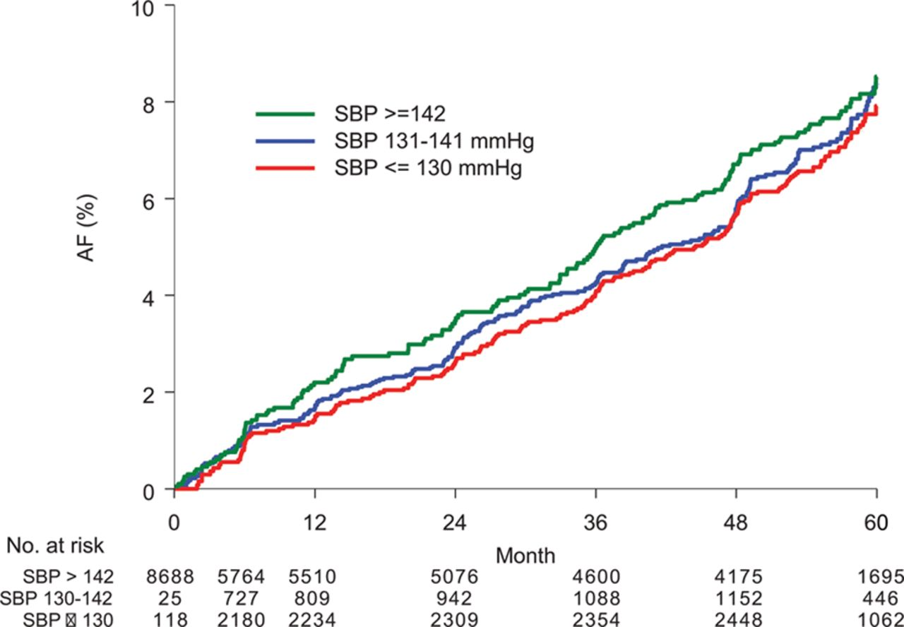
Univariate modified Kaplan–Meier survival curves illustrating the rate of new-onset atrial fibrillation (AF) according to time-varying persistence or development of a systolic blood pressure (SBP) of ≤130 mm Hg and of 131 to 141 mm Hg compared with a systolic blood pressure of ≥142 mm Hg during follow-up.
Peter M. Okin et al. Hypertension. 2015;66:368-373
Copyright © American Heart Association, Inc. All rights reserved.
Notes:
Univariate modified Kaplan–Meier survival curves illustrating the rate of new-onset atrial fibrillation (AF) according to time-varying persistence or development of a systolic blood pressure (SBP) of ≤130 mm Hg and of 131 to 141 mm Hg compared with a systolic blood pressure of ≥142 mm Hg during follow-up. Patient group assignment is adjusted at the time of each blood pressure determination based on the systolic blood pressure at each time.³³

Slide 6
Ajustement pour variables multiples
RR IC (95%) p
130 mmHg 0.60 0.45-0.82 0.001
131 -141 mmHg 0.76 0.62-0.93 0.007
≥ 142 mmHg 1 --- ---
TAS 0.87 0.83-0.91 <0.001
(Chaque 10 mmHg)
Ajustement pour âge, sexe, race, diabète, MCAS, infarctus du myocarde, insuffisance cardiaque, tx antihypertensive antérieure, glucose, créatinine, HDL et non-HDL cholestérol, ratio albumine/créatinine, HVG, TAD

Slide 7
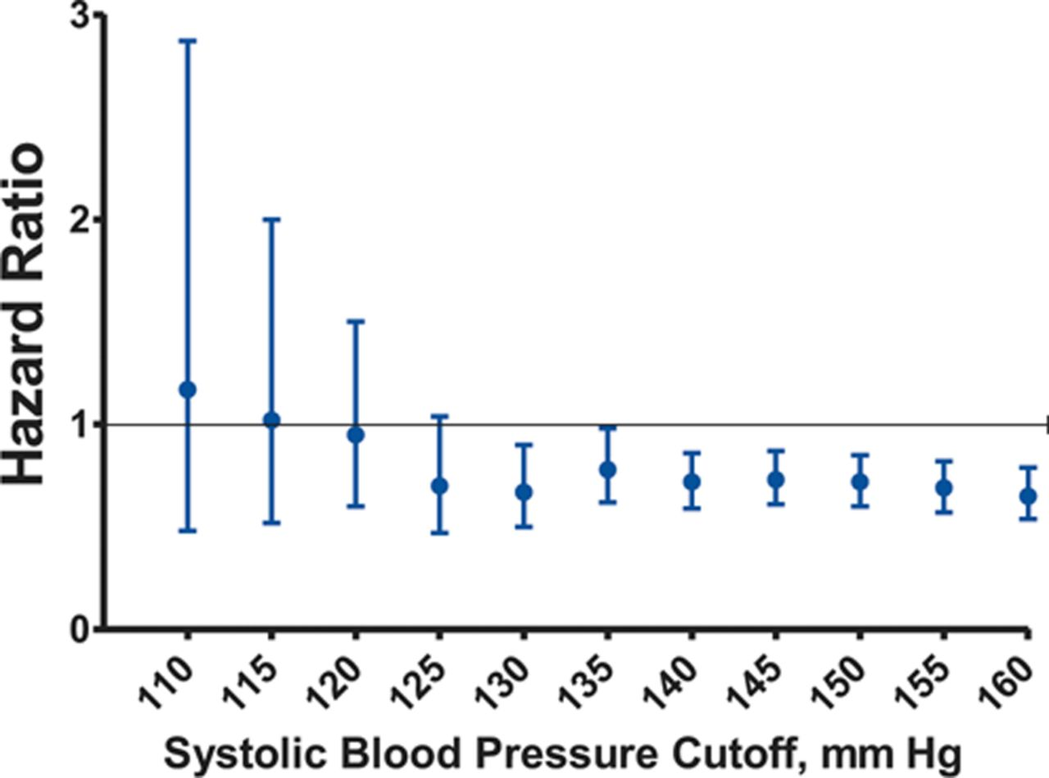
Hazard ratios for new-onset atrial fibrillation according to on-treatment systolic blood pressure by 5 mm Hg cutoff values (adjusted for multiple variables).
TA moyenne au départ:
174/98 sans FA
177/97 avec FA
Peter M. Okin et al. Hypertension. 2015;66:368-373
Copyright © American Heart Association, Inc. All rights reserved.
Notes:
Hazard ratios for new-onset atrial fibrillation according to on-treatment systolic blood pressure by 5 mm Hg cutoff values, adjusted for the effects of treatment with losartan versus atenolol, age, sex, race, diabetes mellitus, history of ischemic heart disease, myocardial infarction or heart failure, previous antihypertensive therapy, baseline serum glucose and creatinine, urine albumin/creatinine ratio, Sokolow–Lyon voltage and QRS duration entered as standard covariates and incident myocardial infarction, incident heart failure and baseline and in-treatment diastolic blood pressure, Cornell product left ventricular hypertrophy, heart rate, high-density lipoprotein cholesterol (HDL), and non-HDL cholesterol entered as time-varying covariates.

Slide 8
Limitations
Analyse post-hoc
Pas de sous-groupes pré-définis selon TAS de départ
La majorité des patients n’ont pas eu d’échographie cardiaque pour mesure de l’OG
Patients randomisés pour la présence d’HVG;
→ peut-être pas valide pour une population générale
Présence de FA seulement mesurée au moment d’une visite prévue

Slide 9
Less-Tight versus Tight Control of Hypertension in Pregnancy
(CHIPS)
Laura A. Magee, M.D., Peter von Dadelszen, M.B., Ch.B., D.Phil., Evelyne Rey, M.D., Susan Ross, M.B.A., Ph.D., Elizabeth Asztalos, M.D., Kellie E. Murphy, M.D., Jennifer Menzies, M.Sc., Johanna Sanchez, M.I.P.H., Joel Singer, Ph.D., Amiram Gafni, D.Sc., Andrée Gruslin, M.D., Michael Helewa, M.D., Eileen Hutton, Ph.D., Shoo K. Lee, M.D., Ph.D., Terry Lee, Ph.D., Alexander G. Logan, M.D., Wessel Ganzevoort, M.D., Ph.D., Ross Welch, M.B., B.S., D.A., M.D., Jim G. Thornton, M.B., Ch.B., M.D., and Jean-Marie Moutquin, M.D.
N Engl J Med 2015; 372:407-417. January 29, 2015

Slide 10
Introduction
10% des femmes enceintes sont hypertendues:
→ 1% préexistante
→ 5-6% gestationnelle (sans protéinurie)
→ 2% pré-éclampsie
HTA pendant la grossesse est associée à des complications périnatales et maternelles
Les cibles tensionnelles ne sont pas claires (définies)
Données disponibles limitées sur contrôle serré TA
Étude randomisée, ouverte, groupe contrôle; HTA préexistante ou gestationnelle
Critères d’admissibilité: 14-33 semaines, auscultatoire, TAD=90-105 mmHg sans tx ou 85-105 mmHg avec tx
cible pour TAD habituelle = 100 mmHg
cible pour TAD serrée = 85 mmHg

Slide 11
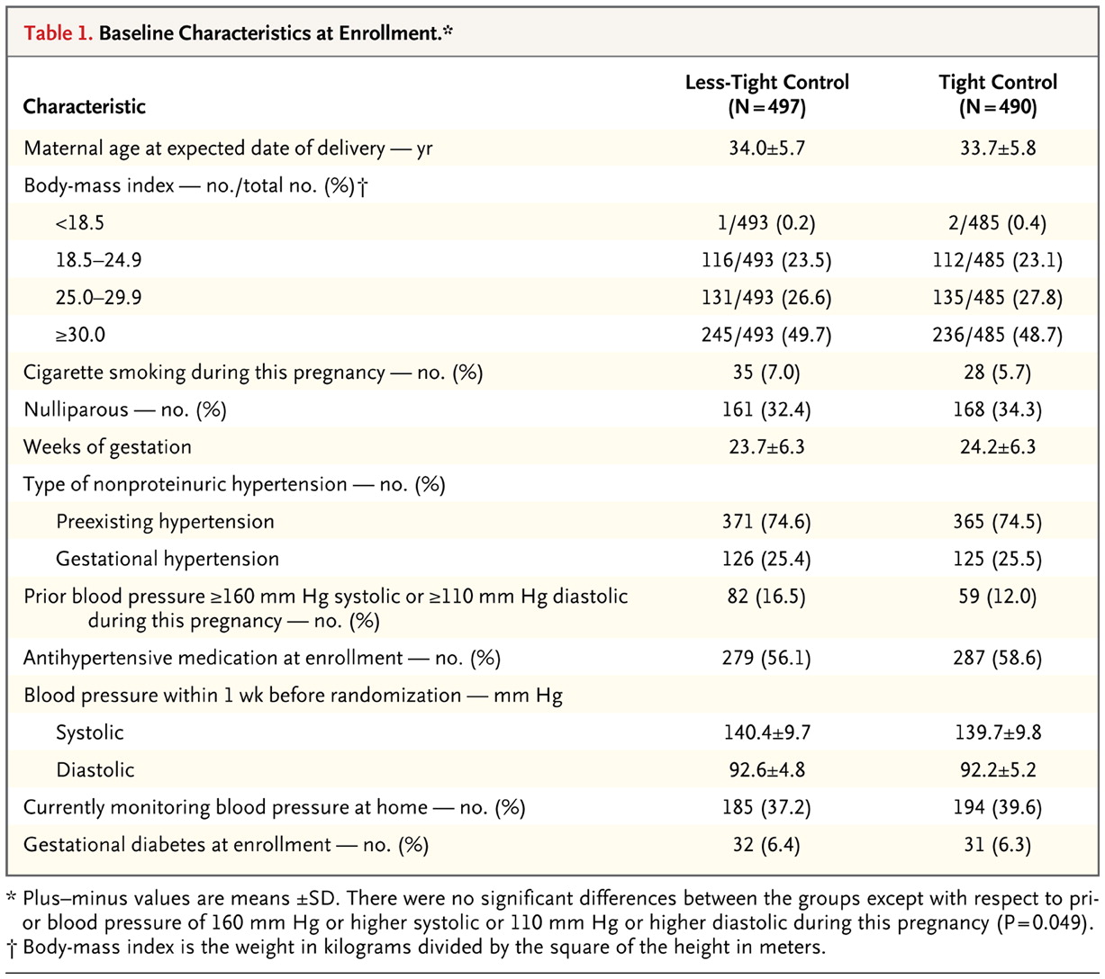
Magee LA et al. N Engl J Med 2015;372:407-417.

Slide 12
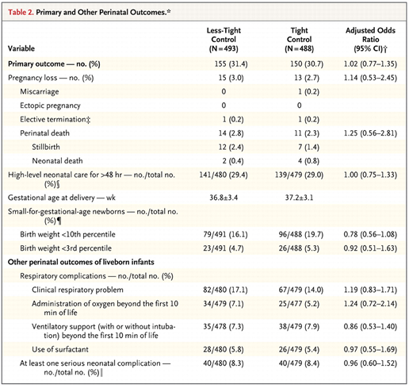
Magee LA et al. N Engl J Med 2015;372:407-417.
comes.
Moins serré:
→ TA=138.8/89.9
Plus serré:
→ TA=133.1/85.3
TAS ↓ 5.8 (4.5-7.0)
TAD ↓ 4.6 (3.7-5.4)
Bénéfice 2⁰ (complications maternelles): pas de différence entre les 2 groupes

Slide 13
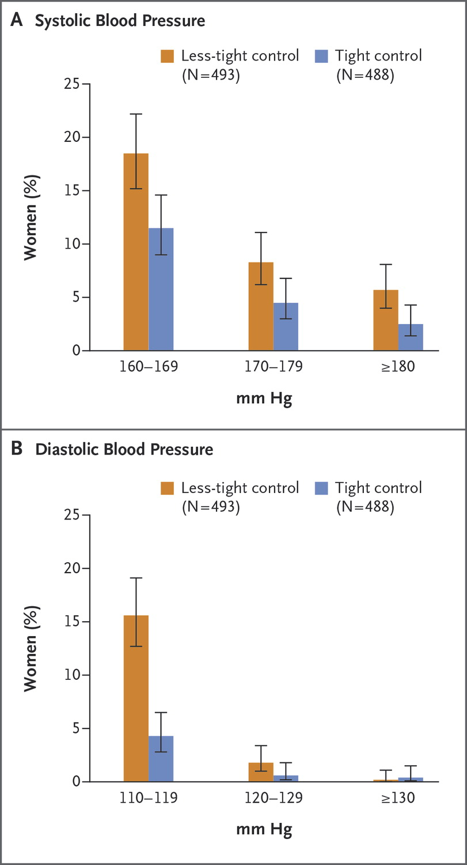
Magee LA et al. N Engl J Med 2015;372:407-417.
on.
Limitations
Peu de séparation des TA moyennes en considérant les IC’s
Antihypertenseur de choix (labetolol) utilisé chez seulement ⅔ des patientes
Age fœtale très variable
Pas de conclusion quant à la cible tensionnelle, sauf pour plus de cas d’HTA sévère dans le groupe de contrôle moins serré
Notes:
Figure 2. Blood-Pressure Values among Women with Severe Hypertension. Panel A shows the percentage of women with systolic blood pressure of 160 mm Hg or higher, and Panel B shows the percentage of women with diastolic blood pressure of 110 mm Hg or higher. I bars represent 95% confidence intervals.

Slide 14
Spironolactone versus placebo, bisoprolol, and doxazosin to determine the optimal treatment for drug-resistant hypertension (PATHWAY-2): a randomised, double-blind, crossover trial
Prof Bryan Williams, FRCP, Prof Thomas M MacDonald, FRCP, Steve Morant, PhD, Prof David J Webb, FMedSci, Prof Peter Sever, FRCP, Prof Gordon McInnes, FRCP, Prof Ian Ford, PhD, Prof J Kennedy Cruickshank, FRCP, Prof Mark J Caulfield, FMedSci, Prof Jackie Salsbury, RGN, Isla Mackenzie, FRCP, Sandosh Padmanabhan, FRCP, Prof Morris J Brown, FMedSci for The British Hypertension Society's PATHWAY Studies Group
Published online September 21, 2015

Slide 15
Introduction
Quel est le meilleur antihypertenseur après A+C+D ?
Possiblement un antagoniste de l’aldostérone
(Dahal K, Am J Hypertension, online March 23, 2015)
Spironolactone sera comparée au doxazocin (α bloquant) et au bisoprolol (β1 bloquant adrénergique)
Étude randomisée, double insu, contrôlé par placebo
N = 314; tous traités par 3 médicaments ≥ 3 mois
Durée d’une année; 4 cycles avec crossover
Bénéfice primaire: spironolactone est le plus efficace?
Bénéfice secondaire: effet sur TA au bureau, taux de contrôle de la TA à domicile, concentrations de rénine

Slide 16
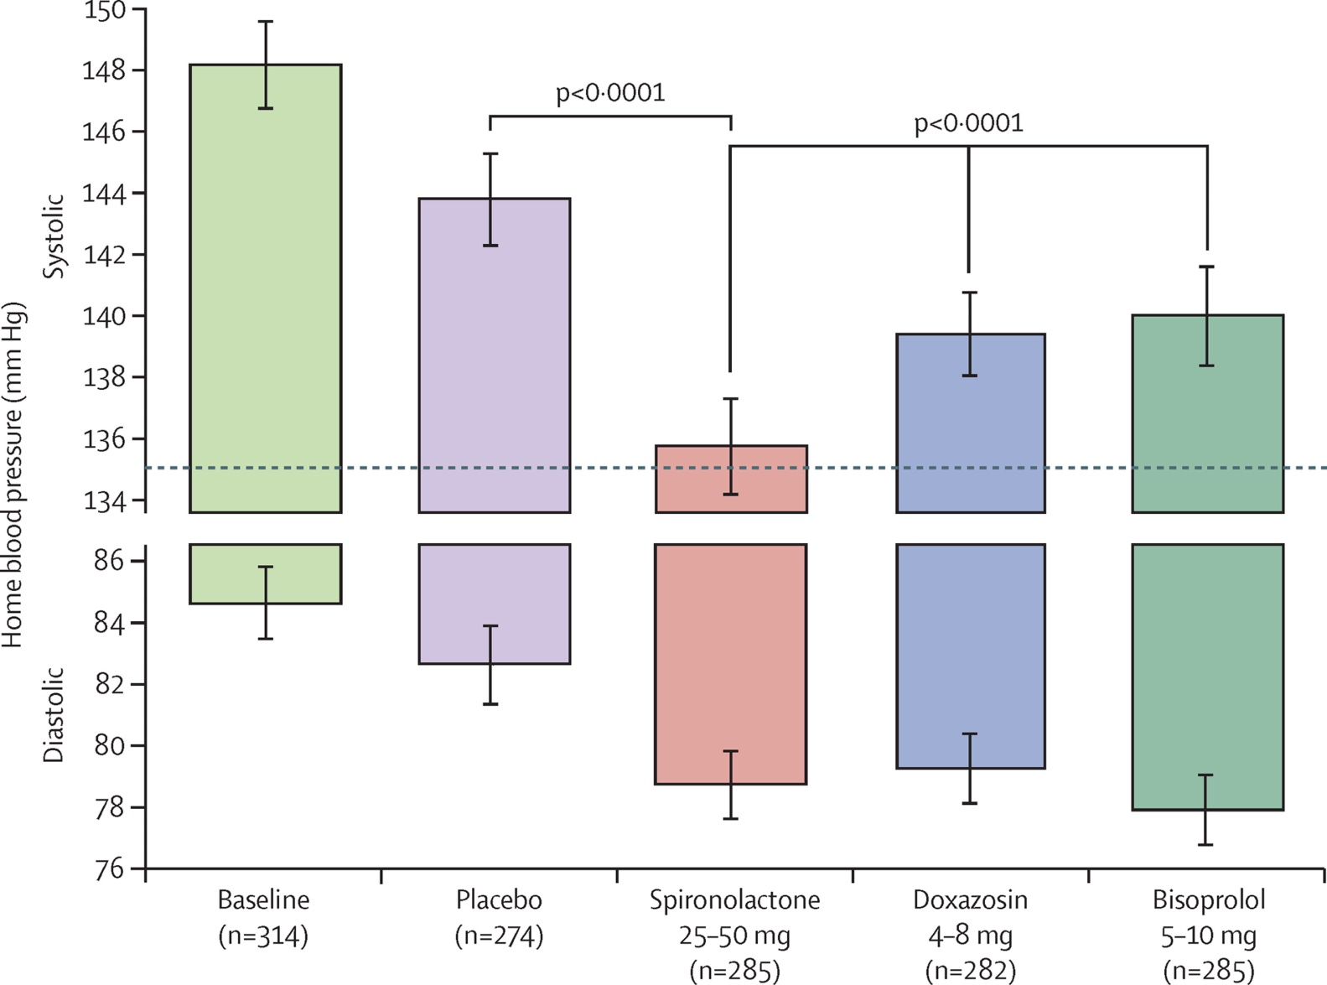
Figure 2
TAS et TAD à domicile comparant spironolactone avec chaque autre cycle
148/84
144
139
135
139
→ 58 % des patients avec TA contrôlée avec spironolactone
Bryan Williams, The Lancet, September 2015
Notes:
Home systolic and diastolic blood pressures comparing spironolactone with each of the other cycles
The top and bottom of each column represents the unadjusted home systolic and diastolic blood pressures, respectively, averaged across the mid-cycle (low-dose) and end-of-cycle (high-dose) visits (6 weeks and 12 weeks) in which patients received the drug. Error bars represent 95% CI. Comparisons are as described under methods for the primary endpoint.

Slide 17
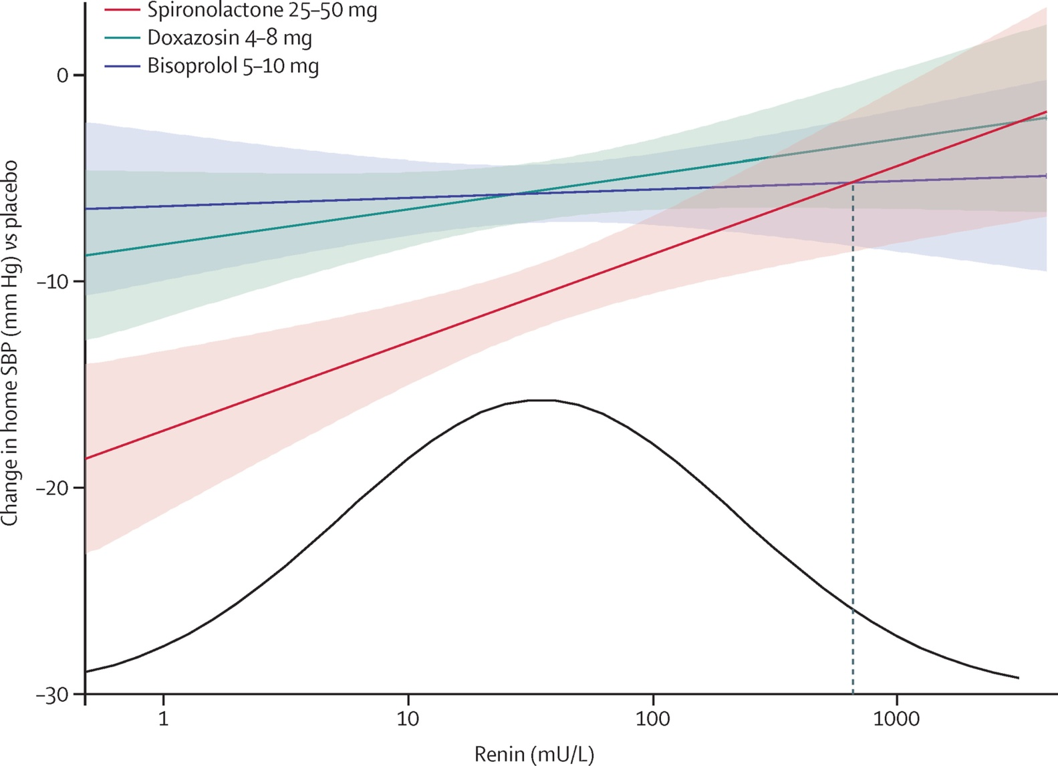
Figure 3
Changement de la TA selon le niveau de rénine
The Lancet 2015 386, 2059-2068DOI: (10.1016/S0140-6736(15)00257-3)
Notes:
Blood pressure response versus renin
Regression (90% CI) of placebo corrected change in home systolic blood pressure versus renin for spironolactone (r²=0·037, p=0·003), doxazosin (r²=0·007, p=0·183), and bisoprolol (r²=0·0004, p=0·750). Blood pressures were averaged across the mid-cycle and end-of-cycle visits (6 and 12 weeks) for every treatment cycle. The distribution curve is fitted to the baseline renins observed in the study. The vertical dashed line shows that the blood pressure fall on bisoprolol numerically exceeds that on spironolactone only in the top 3% of the renin distribution. A more detailed histogram for plasma renin is shown in the appendix (p 20).

Slide 18
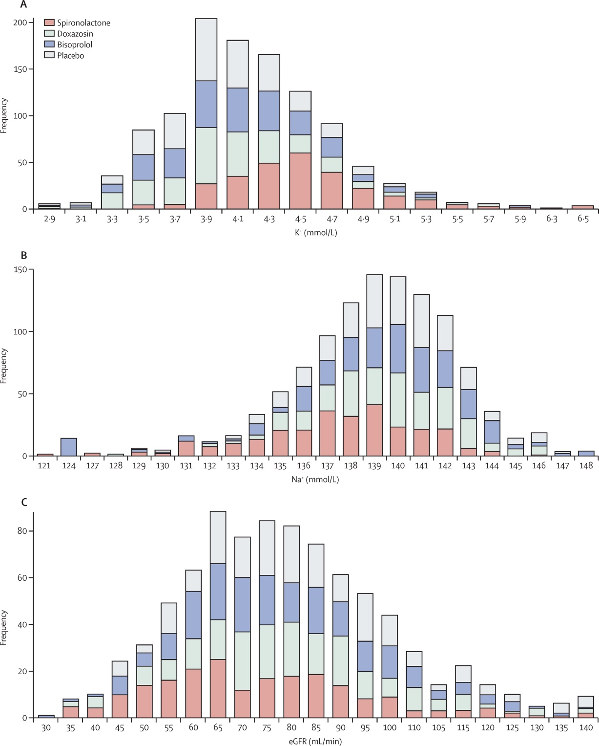
Figure 4
À la fin de chaque cycle
Niveau de K+
Niveau de Na+
TFGe
Notes:
Distribution of potassium (A), sodium (B), and estimated glomerular filtration rate (eGFR; C) on each drug
Values on the x axis are the measurement at the end of each 12-week cycle, and the y axis represents the number of patients with values in each bin on the x axis.

Slide 19
Limitations
Niveau d’aldostérone non mesuré
Petit nombre de sujets
Patients avec TGFe < 45 ml/min exclus
Caucasiens presqu’exclusivement
Pas de données morbidité/mortalité

Slide 20
Magnitude of Blood Pressure Reduction and Clinical Outcomes in Acute Intracerebral Hemorrhage (INTERACT2)
by Xia Wang, Hisatomi Arima, Emma Heeley, Candice Delcourt, Yining Huang, Jiguang Wang, Christian Stapf, Thompson Robinson, Mark Woodward, John Chalmers, and Craig S. Anderson
Hypertension
Volume 65(5):1026-1032
April 8, 2015
Copyright © American Heart Association, Inc. All rights reserved.

Slide 21
Introduction
Poussée hypertensive est fréquente dans un état d’hémorragie intracérébrale aigue
Méta-analyse de petites études randomisées a démontré un bénéfice modeste < TAS de 10 mmHg avec courbe J
N=2829 distribués dans 3 groupes:
→ < 10 mmHg
→ 10 – 20 mmHg
→ ≥ 20 mmHg
But: TAS < 140 en une heure et à maintenir ≥ 7 jours vs standard < 180 mmHg
Bénéfice primaire: décès ou séquelles majeures
Bénéfice secondaire: fonction physique
90 jours

Slide 22
Données démographiques au départ
Réduction de TA (mmHg)
< 10 10 – 20 ≥ 20
Nombre 216 361 2127
Age moyen (ans) 65 64 63
Hémorragie antérieure 11% 9% 8%
AVC antérieur 16% 12% 11%
MCAS 14% 7% 11%
Diabète 10% 11% 11%
Hx HTA 76% 73% 72%
Antihypertenseurs 51% 47% 44%

Slide 23
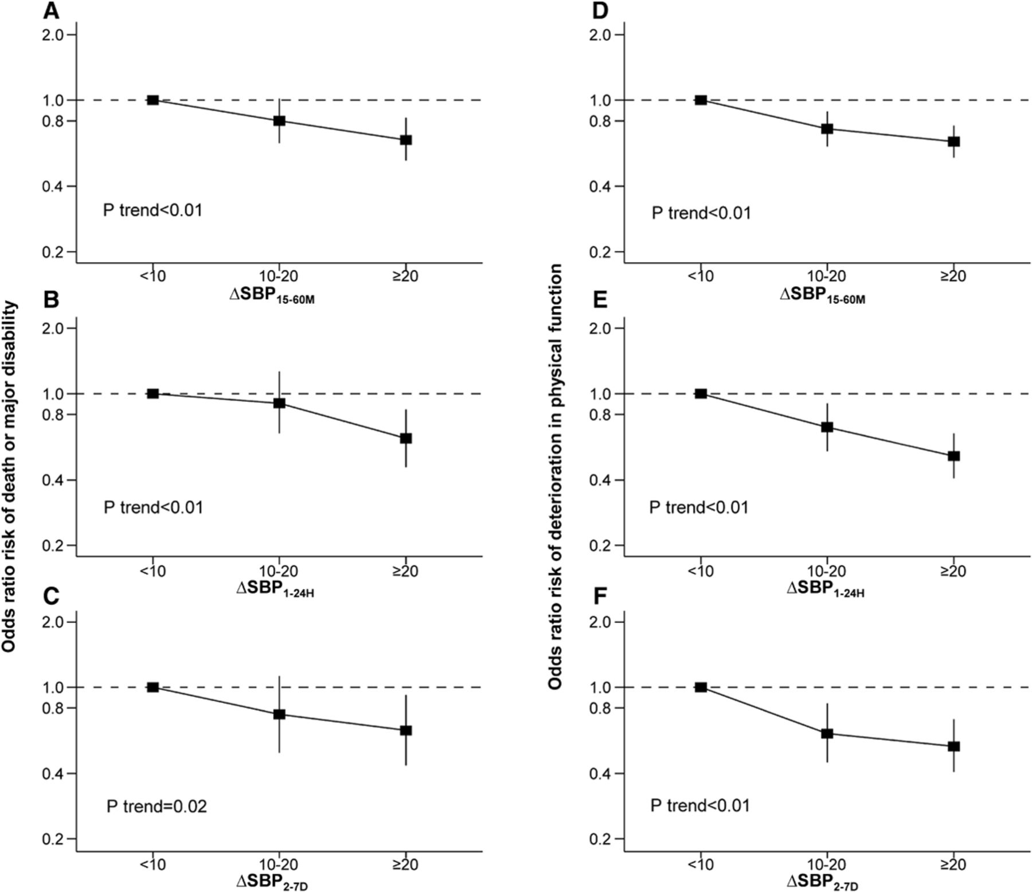
Risk of death or major disability (left; A–C) and of deterioration in physical function across all 7 levels of the modified Rankin Scale (shift analysis; right; D–F), according to blood pressure (BP) reduction levels (categories) during the follow-up period.
Xia Wang et al. Hypertension. 2015;65:1026-1032
Copyright © American Heart Association, Inc. All rights reserved.
Notes:
Risk of death or major disability (left; A–C) and of deterioration in physical function across all 7 levels of the modified Rankin Scale (shift analysis; right; D–F), according to blood pressure (BP) reduction levels (categories) during the follow-up period. Adjusted factors are age, sex, China region, history of hypertension, time from intracerebral hemorrhage onset to randomization ≥4 hours, National Institutes of Health Stroke Scale ≥15, baseline BP, baseline hematoma volume and location, intraventricular extension, and randomized treatment. Solid boxes represent odds ratio of outcome. Vertical lines represent 95% confidence intervals. The P trend tested the consistency of risk of outcome among subgroups. Δ Systolic BP (SBP)_{15–60M}: baseline SBP minus the mean of achieved SBP levels during 15 to 60 minutes. ΔSBP_{1–24H}: baseline SBP minus the mean of achieved SBP levels during 1 to 24 hours. ΔSBP_{2–7D}: baseline SBP minus the mean of achieved SBP levels during 2 to 7 days.

Slide 24
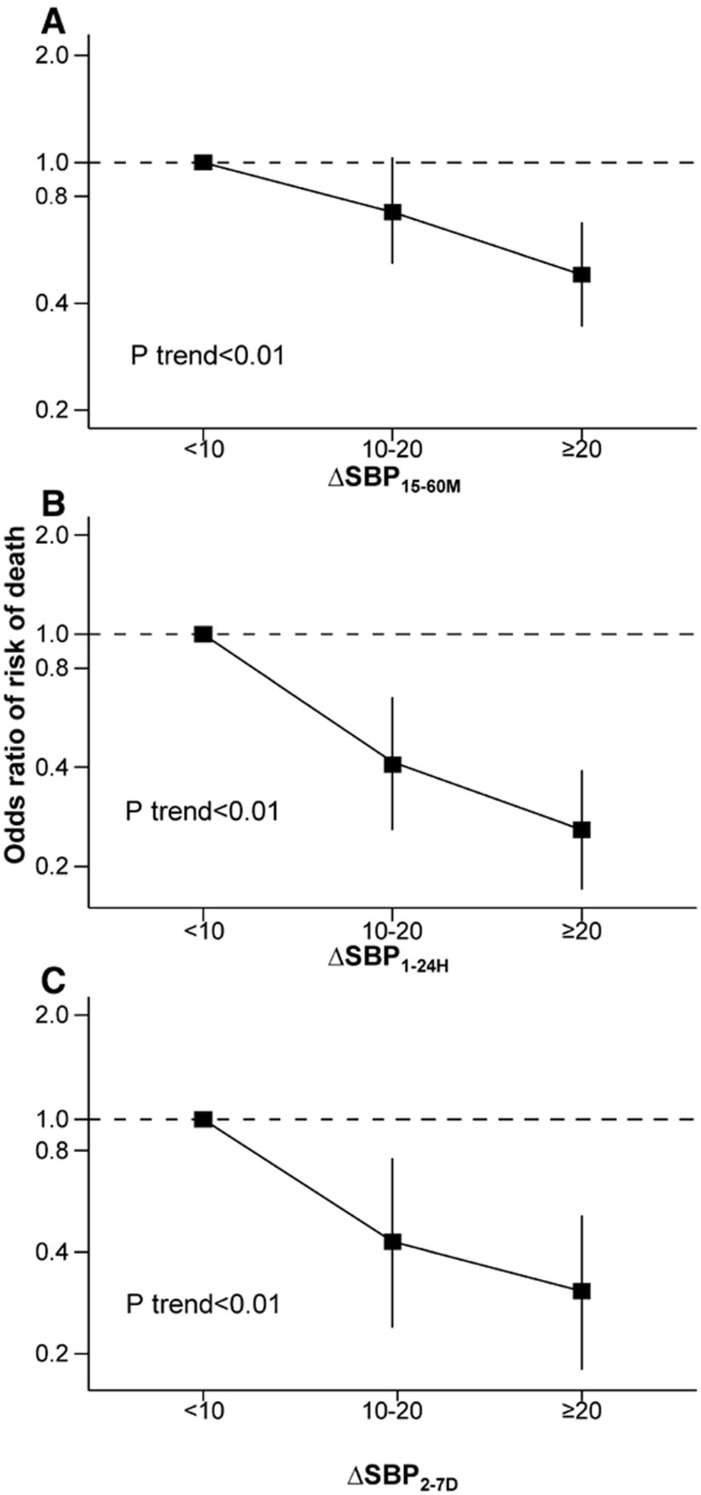
Risk of death according to blood pressure (BP) reduction levels (categories) during the follow-up period
< 10: -67.25 à 8.3
10-20: 8.5 à 22.25
≥ 20: 22.5 à 97.5
< 10: -37 à 21.5
10-20: 21.6 à 37.7
≥ 20: 37.8 à 105.2
<10: -29 à 26.3
10-20: 26.3 à 41.4
≥ 20: 41.4 à 121
Xia Wang et al. Hypertension. 2015;65:1026-1032
Copyright © American Heart Association, Inc. All rights reserved.
Notes:
Risk of death according to blood pressure (BP) reduction levels (categories) during the follow-up period. Adjusted factors are age, sex, China region, history of hypertension, time from intracerebral hemorrhage onset to randomization ≥4 hours, National Institutes of Health Stroke Scale ≥15, baseline BP, baseline hematoma volume and location, intraventricular extension, and randomized treatment. Solid boxes represent odds ratio of outcome. Vertical lines represent 95% confidence intervals. The P trend tested the consistency of risk of outcome among subgroups. Δ Systolic BP (SBP)_{15–60M}: baseline SBP minus the mean of achieved SBP levels during 15 to 60 minutes. ΔSBP_{1–24H}: baseline SBP minus the mean of achieved SBP levels during 1 to 24 hours. ΔSBP_{2–7D}: baseline SBP minus the mean of achieved SBP levels during 2 to 7 days.

Slide 25
Limitations
Pas d’algorithme de traitement précis: quel est le meilleur médicament ?
Y-a-t-il une courbe J ?
Effets secondaires non rapportés
Exclusion des patients avec hémorragie sévère ou allant pour une chirurgie
Suivi de seulement 90 jours

Slide 26
SPRINT Research Question
Examine effect of more intensive high blood pressure treatment than is currently recommended
Randomized Controlled Trial Target Systolic BP
Intensive Treatment
Goal SBP < 120 mm Hg
Standard Treatment
Goal SBP < 140 mm Hg
SPRINT design details available at:
ClinicalTrials.gov (NCT01206062)
Ambrosius WT et al. Clin. Trials. 2014;11:532-546.

Slide 27
Major Inclusion Criteria
≥50 years old
Systolic blood pressure : 130 – 180 mm Hg (treated or untreated) → oscillometric BP x 3 at intervals of 5 minutes
Additional cardiovascular disease (CVD) risk
Clinical or subclinical CVD (excluding stroke)
Chronic kidney disease (CKD), defined as eGFR 20 – <60 ml/min/1.73m²
Framingham Risk Score for 10-year CVD risk ≥ 15%
Age ≥ 75 years
At least one

Slide 28
Major Exclusion Criteria
Stroke
Diabetes mellitus
Polycystic kidney disease
Congestive heart failure (symptoms or EF <35%)
Proteinuria >1g/d
CKD with eGFR < 20 mL/min/1.73m² (MDRD)
Adherence concerns

Slide 29
Demographic and Baseline Characteristics
 | Total N=9361 | Intensive N=4678 | Standard N=4683
Mean (SD) age, years | 67.9 (9.4) | 67.9 (9.4) | 67.9 (9.5)
% ≥75 years | 28.2% | 28.2% | 28.2%
Female, % | 35.6% | 36.0% | 35.2%
White, % | 57.7% | 57.7% | 57.7%
African-American, % | 29.9% | 29.5% | 30.4%
Hispanic, % | 10.5% | 10.8% | 10.3%
Prior CVD, % | 20.1% | 20.1% | 20.0%
Mean 10-year Framingham CVD risk, % | 20.1% | 20.1% | 20.1%
Taking antihypertensive meds, % | 90.6% | 90.8% | 90.4%
Mean (SD) number of antihypertensive meds | 1.8 (1.0) | 1.8 (1.0) | 1.8 (1.0)
Mean (SD) Baseline BP, mm Hg
Systolic | 139.7 (15.6) | 139.7 (15.8) | 139.7 (15.4)
Diastolic | 78.1 (11.9) | 78.2 (11.9) | 78.0 (12.0)

Slide 30
Pre-specified 6 Subgroups of Special Interest
Age (<75 vs. ≥75 years)
Gender (Men vs. Women)
Race/ethnicity (African-American vs. Non African-American)
CKD (eGFR <60 vs. ≥60 mL/min/1.73m²)
CVD (CVD vs. no prior CVD)
Level of BP (Baseline SBP tertiles: ≤132, 133 to 144, ≥145 mm Hg)-

Slide 31
Primary Outcome and Primary Hypothesis
Primary outcome
CVD composite: first occurrence of
Myocardial infarction (MI)
Acute coronary syndrome (non-MI ACS)
Stroke
Acute decompensated heart failure (HF)
Cardiovascular disease death
Primary hypothesis*
CVD composite event rate lower in intensive compared to standard treatment
*Estimated power of 88.7% to detect a 20% difference
- based on recruitment of 9,250 participants, 4-6 years of follow-up and loss to follow-up of 2%/year.

Slide 32
Systolic BP During Follow-up
Year 1
Average SBP
(During Follow-up)
Standard: 134.6 mm Hg
Intensive: 121.5 mm Hg
Mean SBP
136.2 mm Hg
Standard
Mean SBP
121.4 mm Hg
Intensive
Average number of
antihypertensive
medications
Number of
participants

Slide 33
SPRINT Primary Outcome and its Components Event Rates and Hazard Ratios
* Étude cessée après 3.26 ans *
 | Intensive |  | Standard
 | No. of Events | Rate, %/year | No. of Events | Rate, %/year | HR (95% CI) | P value
Primary Outcome | 243 | 1.65 | 319 | 2.19 | 0.75 (0.64, 0.89) | <0.001
All MI | 97 | 0.65 | 116 | 0.78 | 0.83 (0.64, 1.09) | 0.19
Non-MI ACS | 40 | 0.27 | 40 | 0.27 | 1.00 (0.64, 1.55) | 0.99
All Stroke | 62 | 0.41 | 70 | 0.47 | 0.89 (0.63, 1.25) | 0.50
All HF | 62 | 0.41 | 100 | 0.67 | 0.62 (0.45, 0.84) | 0.002
CVD Death | 37 | 0.25 | 65 | 0.43 | 0.57 (0.38, 0.85) | 0.005
NNT=61

Slide 35
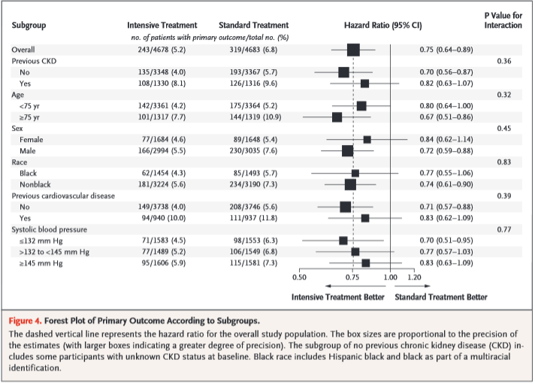
NEJM, November 9, 2015

Slide 36
All-cause Mortality Experience in the Six Pre-specified Subgroups of Interest
*
*p=0.34, after Hommel
adjustment for multiple
comparisons

Slide 37
Questions
Vos patients ont-ils les caractéristiques SPRINT ?
Comment mesurer vous la TA en cabinet ?
Allez-vous individualisé le traitement de vous patients selon SPRINT ?
Le meilleur patient est-il un « old white male » ?

Slide 38
Merci !

